Slide 1
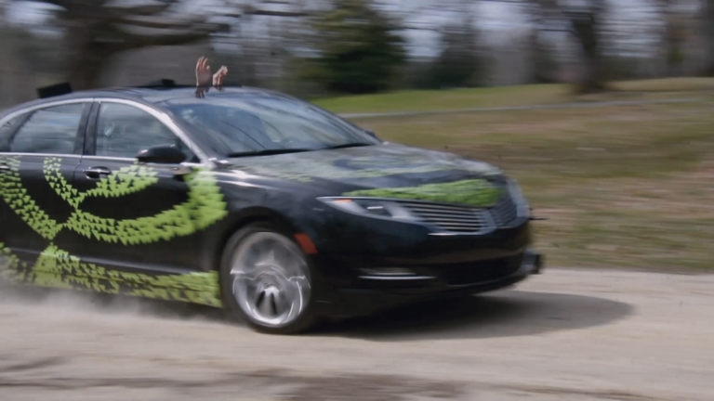
Self Driving Cars

Slide 2
PROBLEM STATEMENT
Supervised regression problem between the car steering angles and the road images in front of a car
use a neural network to clone car driving behavior

Slide 3
APPROACH
DATA GENERATION
TRAINING MODE
TESTING MODE
DATA PREPROCESSING

Slide 4
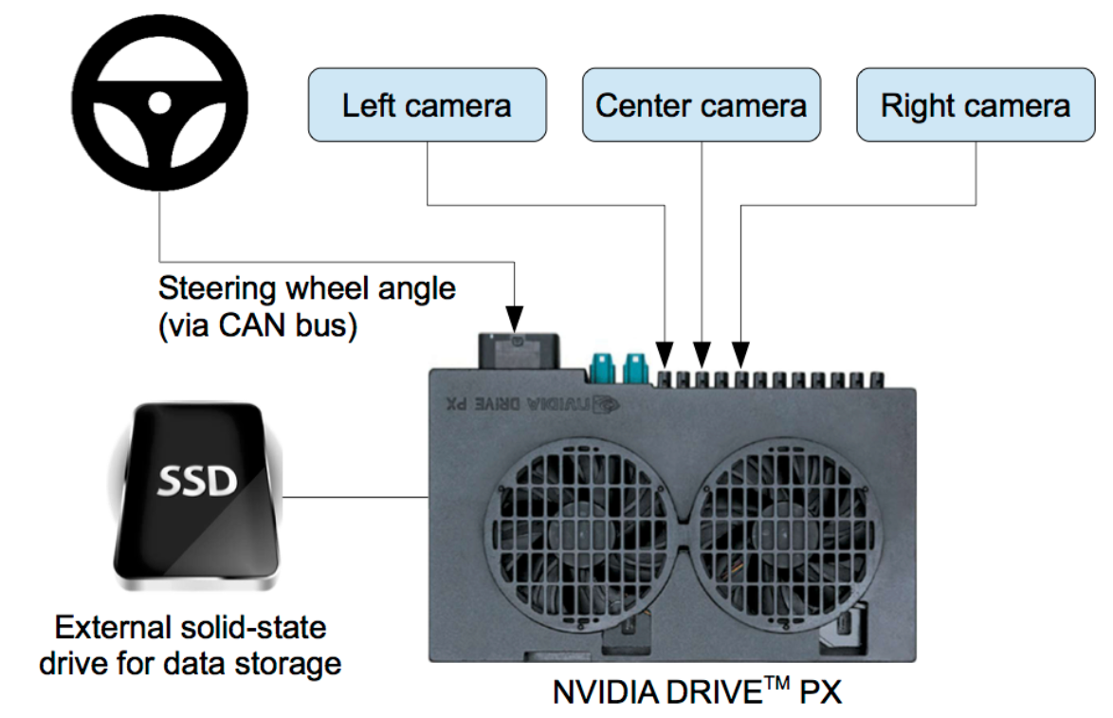
NVIDIA MODEL FOR DATA GENERATION

Slide 5
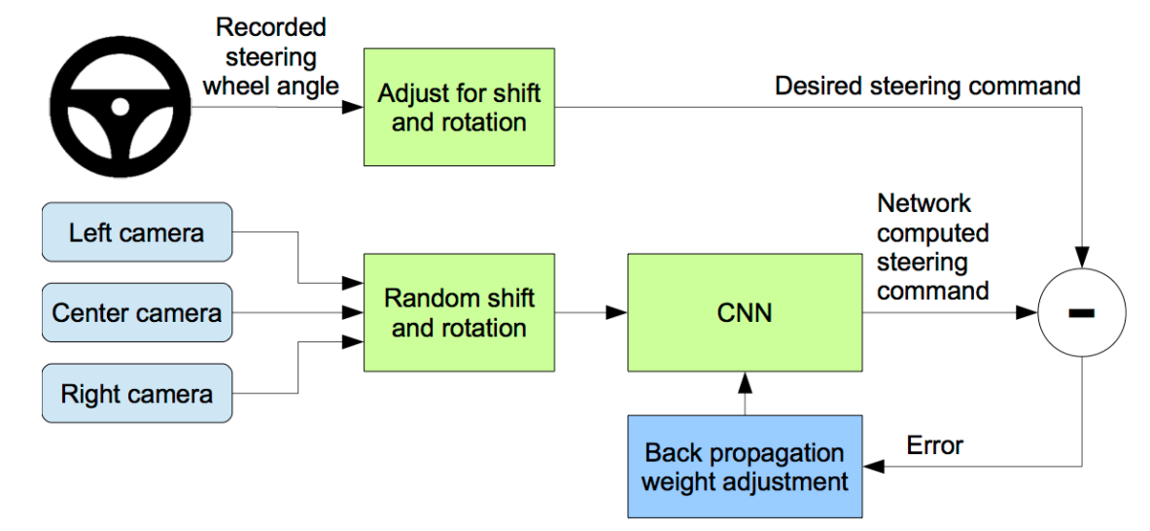
Software Design

Slide 6
Reference
[1] Y. LeCun, B. Boser, J. S. Denker, D. Henderson, R. E. Howard, W. Hubbard, and L. D. Jackel. Backpropagation applied to handwritten zip code recognition. Neural Computation, 1(4):541–551, Winter 1989. URL: http://yann.lecun.org/exdb/publis/pdf/lecun-89e.pdf.
[2] Alex Krizhevsky, Ilya Sutskever, and Geoffrey E. Hinton. Imagenet classification with deep convolutional neural networks. In F. Pereira, C. J. C. Burges, L. Bottou, and K. Q. Weinberger, editors, Advances in Neural Information Processing Systems 25, pages 1097–1105. Curran Associates, Inc., 2012. URL: http://papers.nips.cc/paper/ 4824-imagenet-classification-with-deep-convolutional-neural-networks. pdf.
[3] L. D. Jackel, D. Sharman, Stenard C. E., Strom B. I., , and D Zuckert. Optical character recognition for self-service banking. AT&T Technical Journal, 74(1):16–24, 1995.
[4] Large scale visual recognition challenge (ILSVRC). URL: http://www.image-net.org/ challenges/LSVRC/.
[5] Net-Scale Technologies, Inc. Autonomous off-road vehicle control using end-to-end learning, July 2004. Final technical report. URL: http://net-scale.com/doc/net-scale-dave-report.pdf. [
6] Dean A. Pomerleau. ALVINN, an autonomous land vehicle in a neural network. Technical report, Carnegie Mellon University, 1989. URL: http://repository.cmu.edu/cgi/viewcontent. cgi?article=2874&context=compsci.

Slide 7


